Slide 1
Sprint 1

Slide 2
Contents
What I did?
What’s next?

Slide 3
What I did?
Project plan
Event storming
User story
Architecture diagram
Research plan

Slide 4
User story
User story 1: As a player, I want to select the genre of music and the year that I want to play, so that I can test my knowledge on that specific music.
User story 2: As a player, I want to have the option to choose how many rounds the session has, so that we can play longer or shorter rounds.

Slide 5
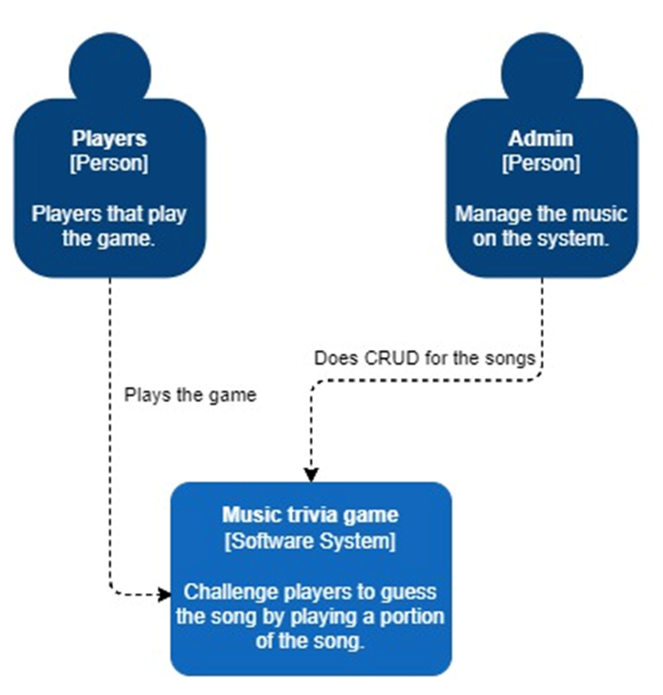
Architecture diagram

Slide 6
What’s next

